Slide 1

Chatbot for mrcet
Batch 10
m.Prajwal : 20n31a1297
p.Omkar : 20n31a12b8
k.Saipranay : 20n31a1291

Slide 2
AGENDA
Purpose
The purpose of the chatbot would be to provide students, prospective students, and parents with quick and easy access to information about the college. The chatbot could be designed to answer common questions about admissions, tuition and fees, financial aid, academic programs, campus life, and other topics of interest to the college community.
The scope of the chatbot would depend on the specific needs and priorities of the college. For example, it could be designed to:
Provide information about the college's history, mission, and values
Answer questions about the application process, admission requirements, and deadlines
Help prospective students find information about academic programs, faculty, and research opportunities
Provide information about campus events, clubs, and activities
Help students connect with campus resources, such as academic advisors, career services, and the library

Slide 3
Introduction
Nowadays, we see the chat bots everywhere Chat bots are the source of answers to the users questions in any particular domain where it is operating.
Chat bots are the source of answers to the users questions in any particular domain where it is operating.
The AI chatbot is able to interpret human language as it is written, which enables them to operate more or less on their own.
It can understand language outside of pre-programmed commands and provide a response based on existing data.
It is a computer program designed to simulate a conversation with human users, over the internet.

Slide 4
Software Requirements
Python
Json file and pickle file for back-end
Python libraries like:
Tkinter
NLTK (Natural language toolkit)
JSON
Pickle
Tensorflow

Slide 5
Hardware Requirements
64-bit CPU (Intel /AMD architecture)
8 GB RAM
5 GB free disk space
256GB SSD
Intel Core i5 or above processor

Slide 6
APPLICATION DESCRIPTION
Our chatbot for the college is a conversational AI tool built using Python programming language and natural language processing (NLP) libraries like NLTK, SpaCy, and TensorFlow.
It is designed to assist and guide current and prospective students, as well as parents and alumni, with a wide range of inquiries related to college admissions, financial aid, academic programs, campus life, and more.
It uses a conversation flow that is designed to provide relevant and accurate information based on the user's specific inquiry, while also offering additional resources and support when needed.
It is also designed to provide personalized support, taking into account the user's specific needs, interests, and preferences, and providing tailored recommendations and guidance accordingly.
Overall, the chatbot for our college is a valuable tool for students, prospective students, parents, and alumni, providing quick and easy access to information and support, and helping to ensure a seamless and successful college experience for all.

Slide 7
working
A chatbot is A computer program that simulates human conversation by using natural language processing (nlp) and machine learning (ml) techniques.
When a user inputs a text message or voice command, the chatbot uses nlp algorithms to understand the user's intent and generates a response based on that intent.
Ai-based chatbots can learn from past interactions to improve their responses over time.
The chatbot can also be integrated with backend systems to provide more personalized responses and automate tasks.
In short, chatbots work by analyzing user input, identifying the user's intent, generating a response, and learning from past interactions to improve their performance.

Slide 8
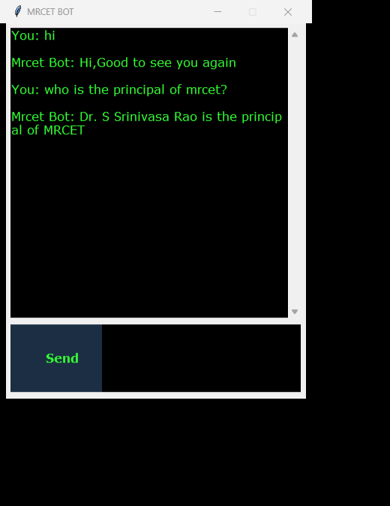
GUI OF CHATBOT
Enter the question in the bottom input box and press send
The chatbot replies to you with an effective answer

Slide 9
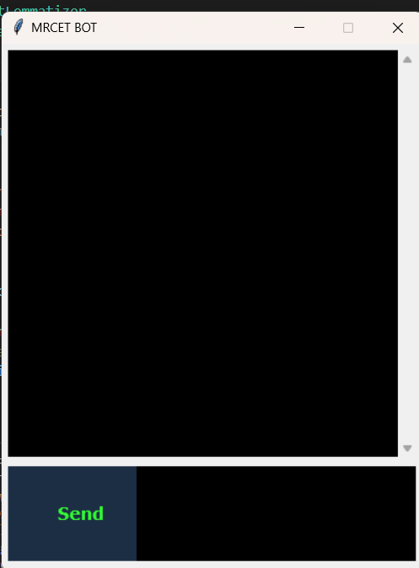
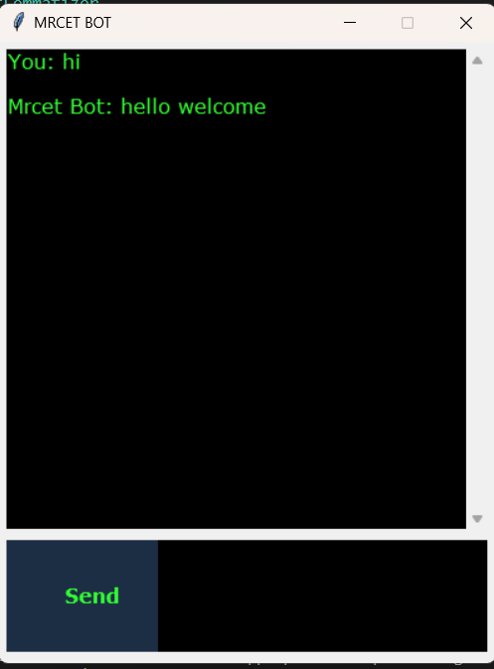
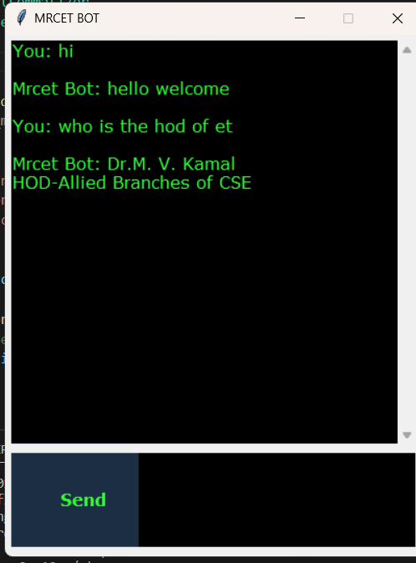
result

Slide 10
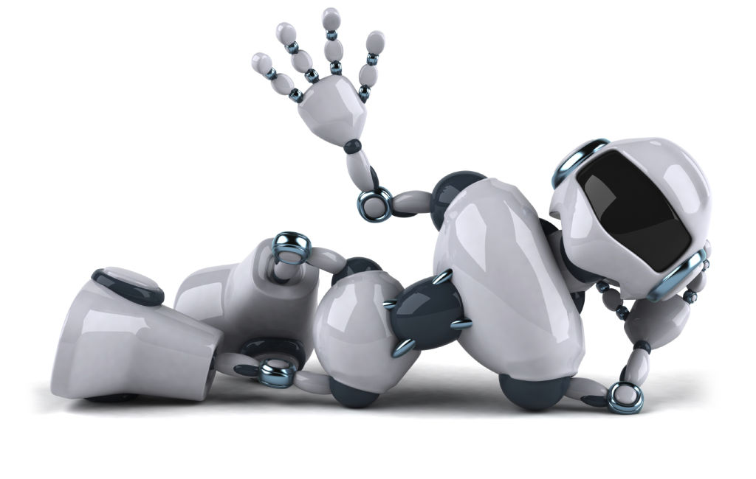
THANK YOU

